Slide 1
Group 3 - lit

Slide 2
About US
Ladies In Tech stylized as LIT, is a group of consisting of 3 women from London and … . Lola, Nini and Tasha are all aspiring to transition to a career in technology as a developer. The Sky Get In To Tech course provided us with the foundation, encouragement and confidence to embark on our technology careers .

Slide 3
The project
Create a blog from scratch using the foundations we have learnt in our 16 week course.
Our blog:- insert url
Inspired by our Get In To Tech programme, we created a blog to help women who wish to transition in to a career in tech. The blog would list stories of women on their career journey in tech, learning tips, useful resources and list of key events.

Slide 4
RAINY DAY vs SUNNY DAY
More pages such as search internships, FAQ page
Comments section under blog posts
Create an admin area
Share function for blogs
Newsletter/ email sign up
Select number of pages
Select functions
3 sprints maximum- Research, build, test

Slide 5
Sprint 1
Finalise blog name
Create Trello board
Research tech blog and gather tech stories and images
Research potential code needed

Slide 6
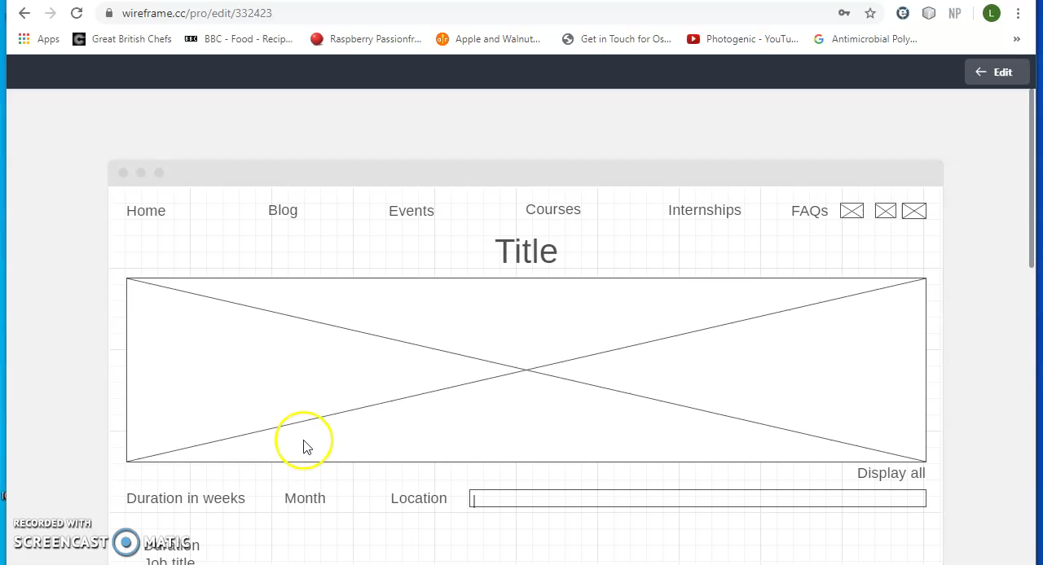
WIREFRAME

Slide 7
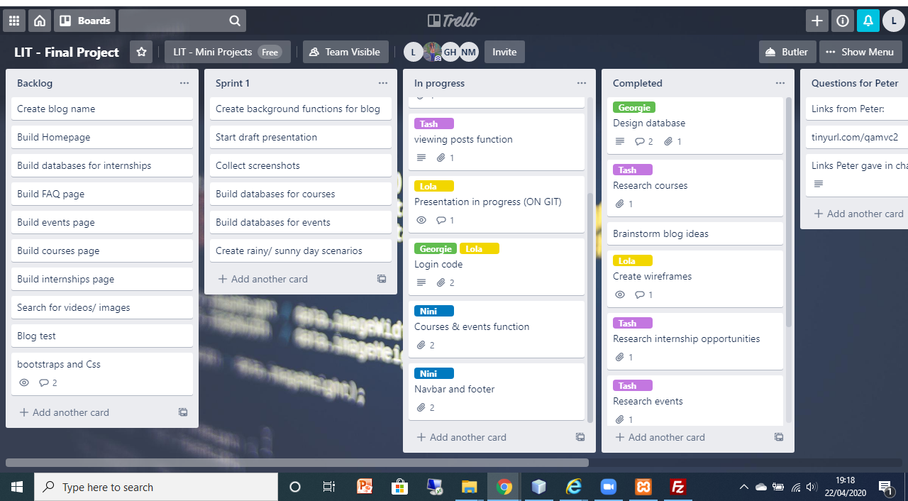
TRELLO BOARD

Slide 8
Sprint 2
Build backend pages
Build frontend pages
Research bootstrap/ styling

Slide 9
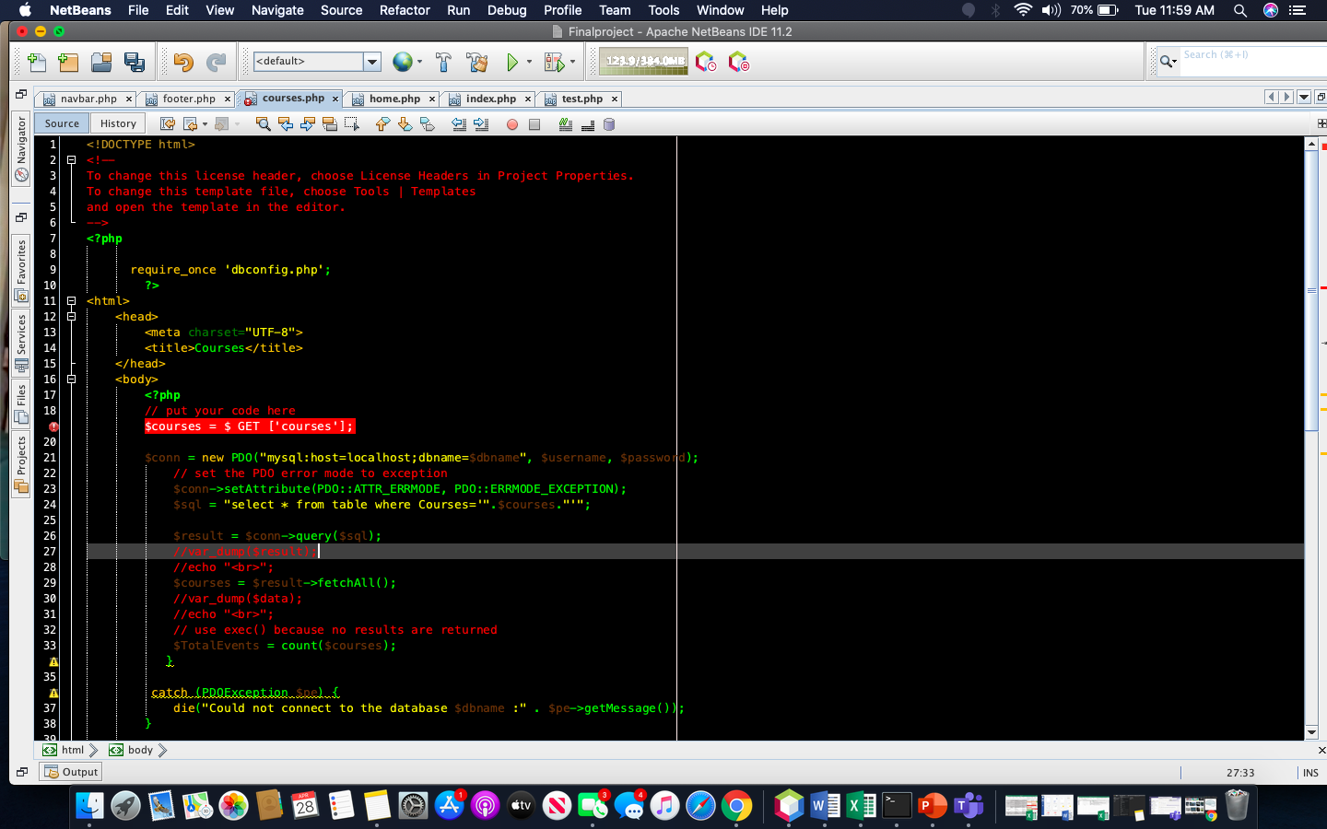
PAGE BUILD

Slide 10
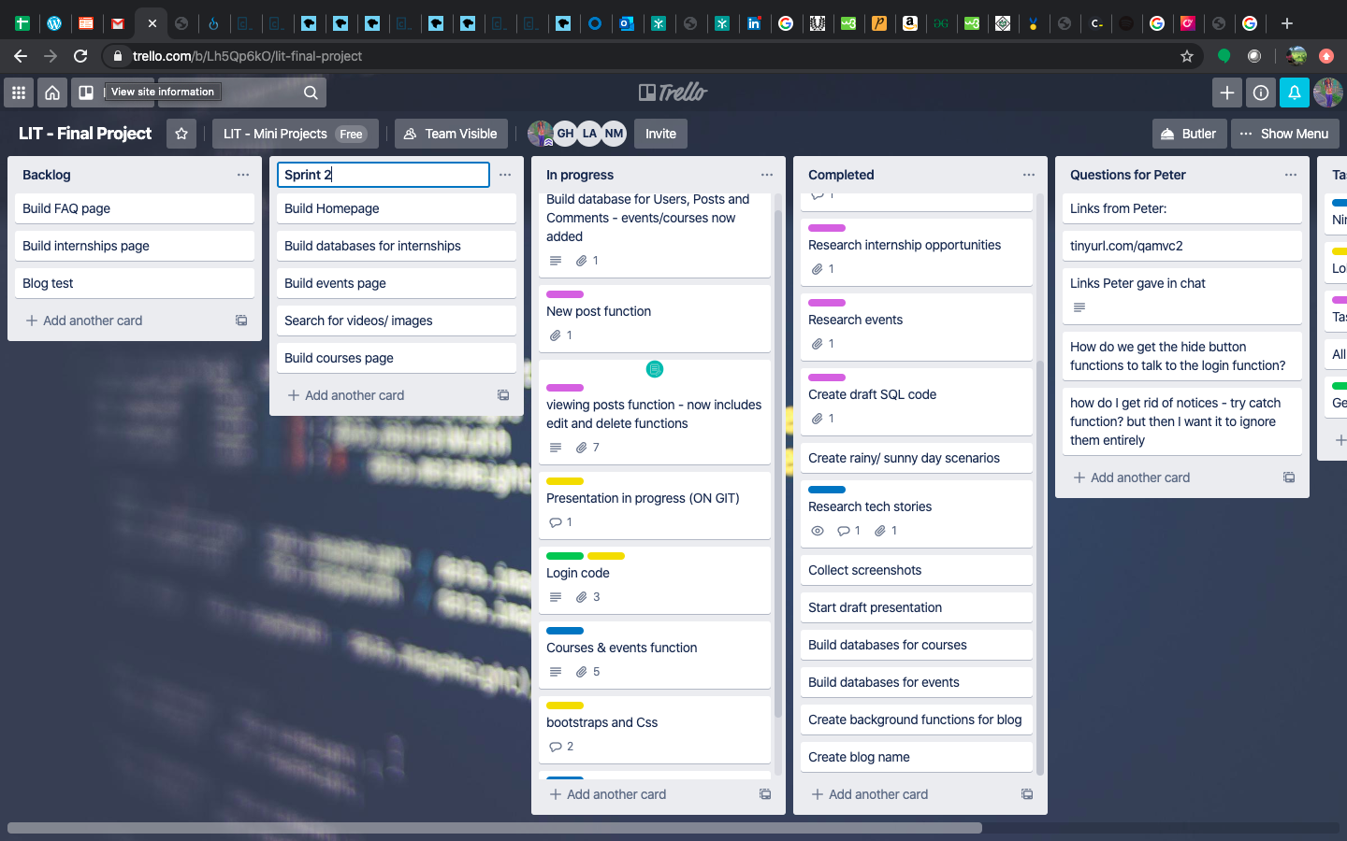
TRELLO BOARD – SPRINT 2

Slide 11
Sprint 3
Test pages
Test all pages link
Build presentation

Slide 12
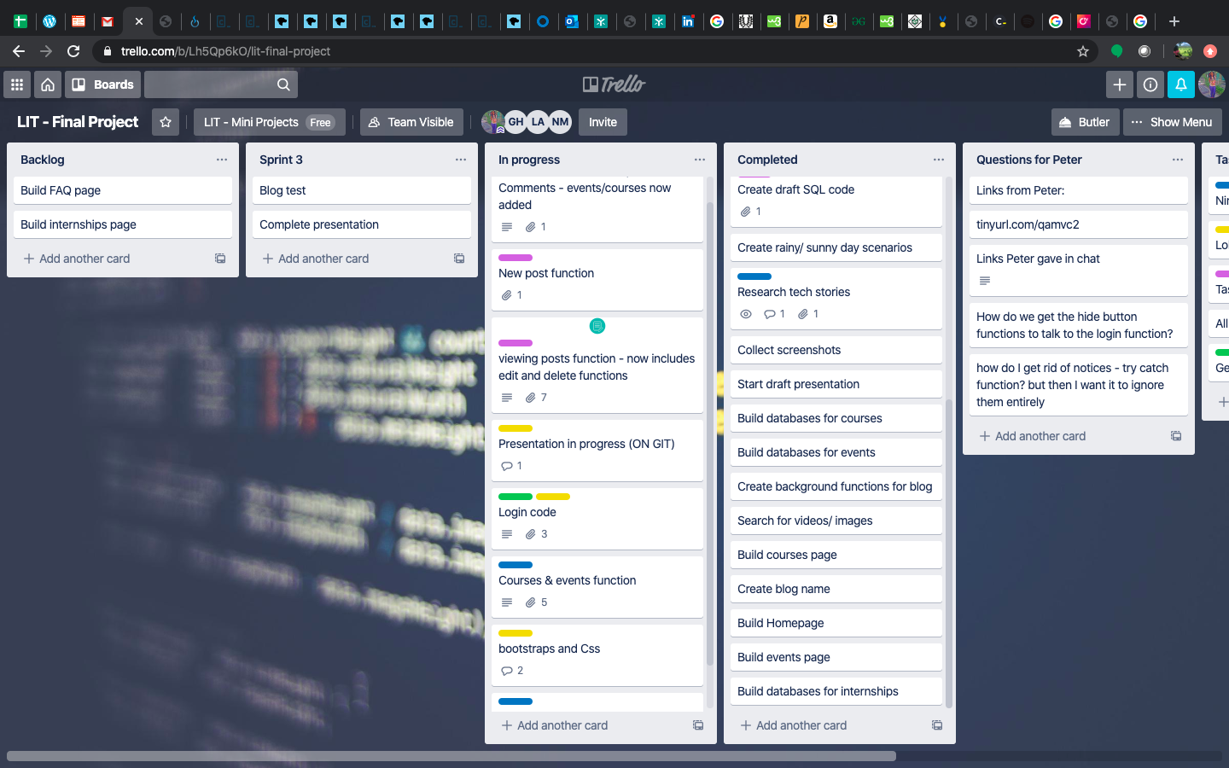
TRELLO BOARD – SPRINT 3

Slide 13
Our BLOG

Slide 14
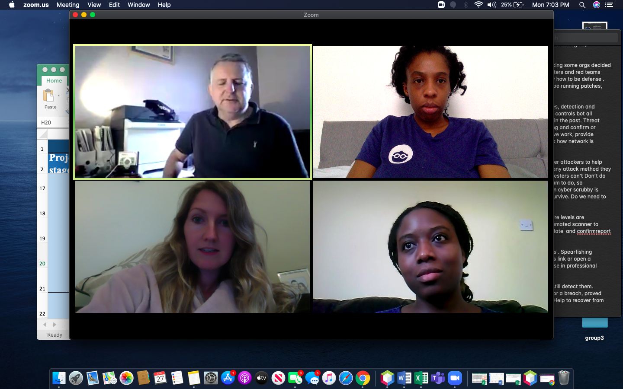
Challenges we faced
Two team members
Time management
Unable to meet up
Technical issues
Explaining technical issues
COVID lockdown

Slide 15
Thank you
From Lola, Tasha & Nini

